Slide 1
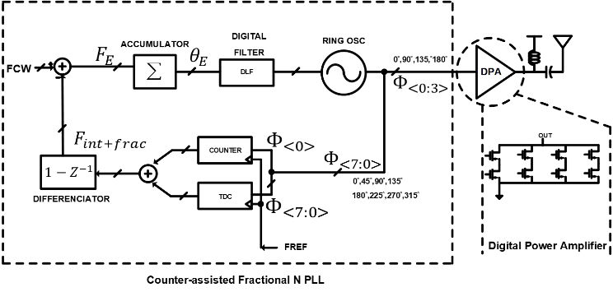
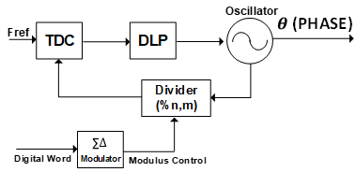
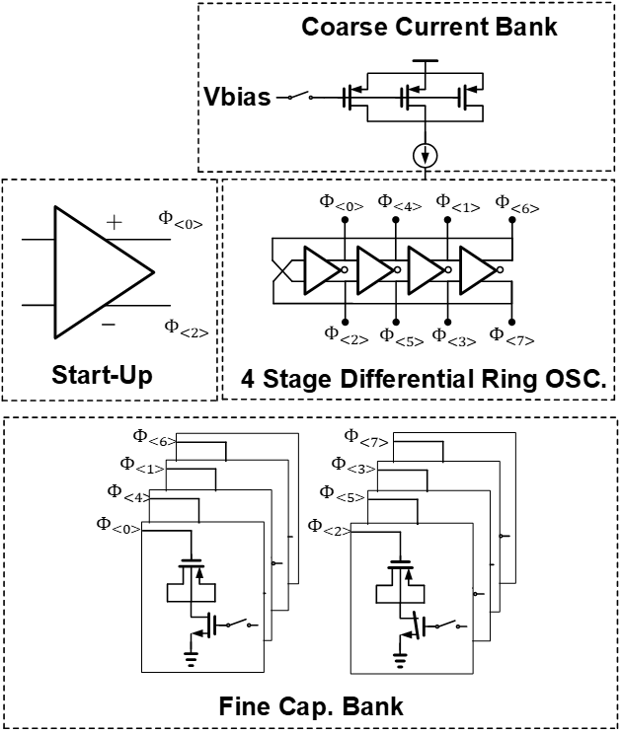
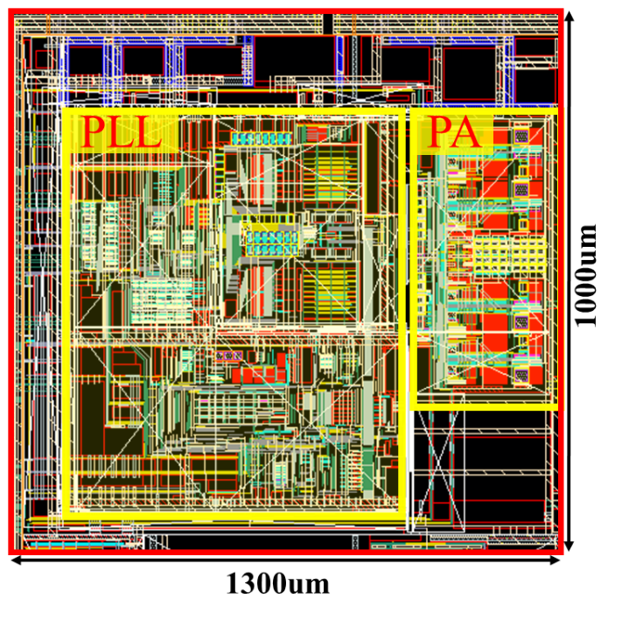
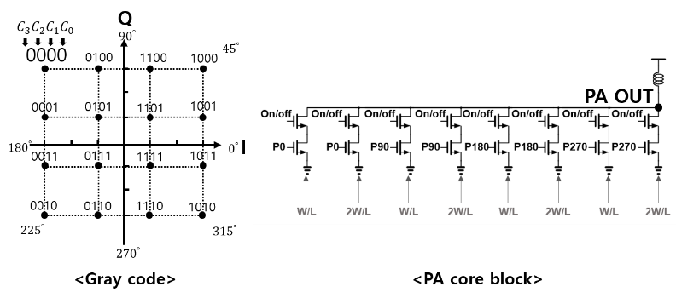
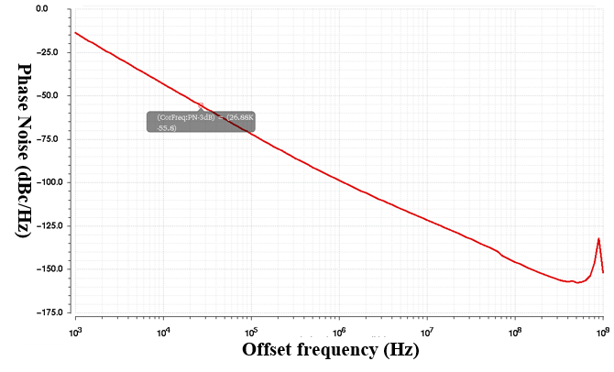
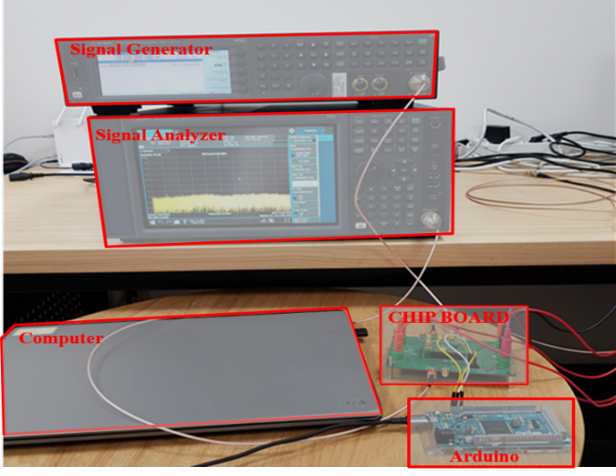
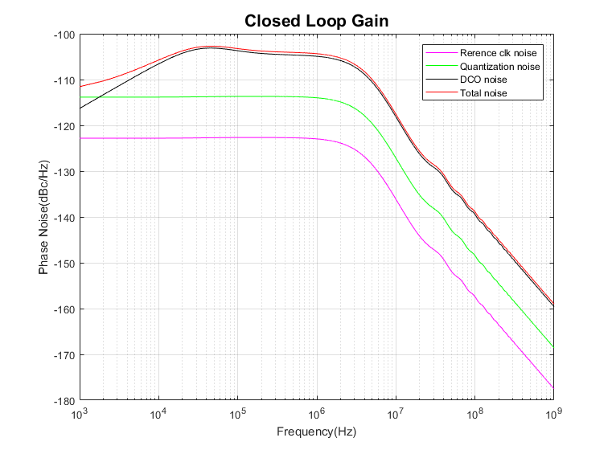
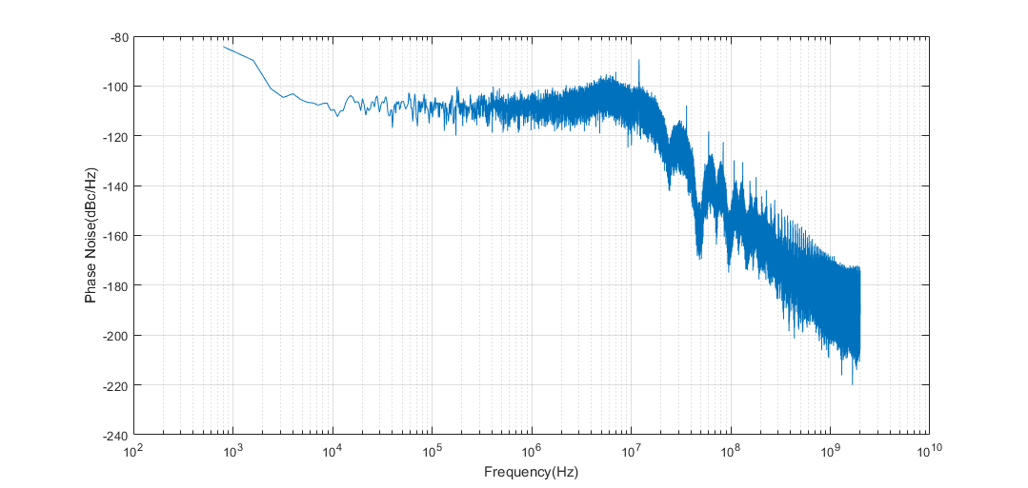
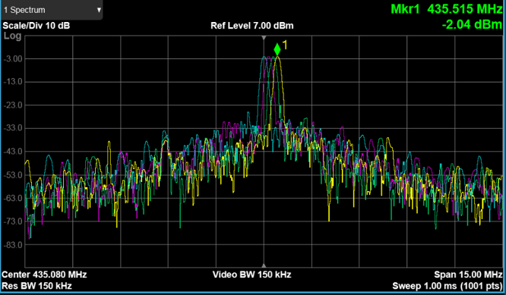
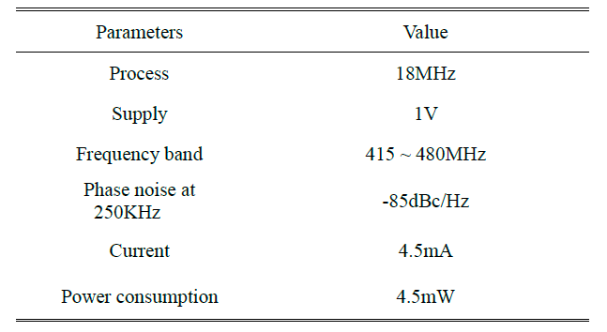
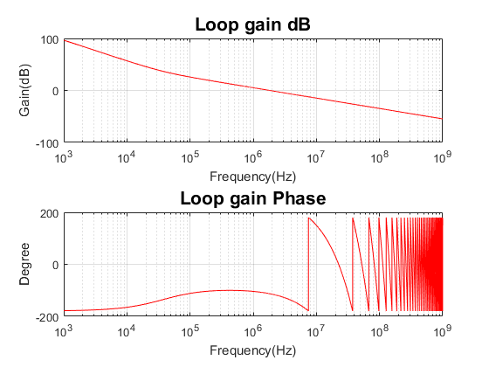
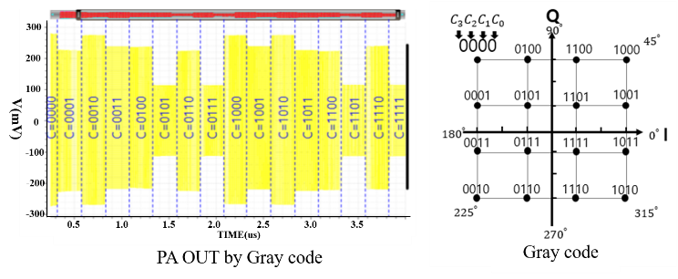
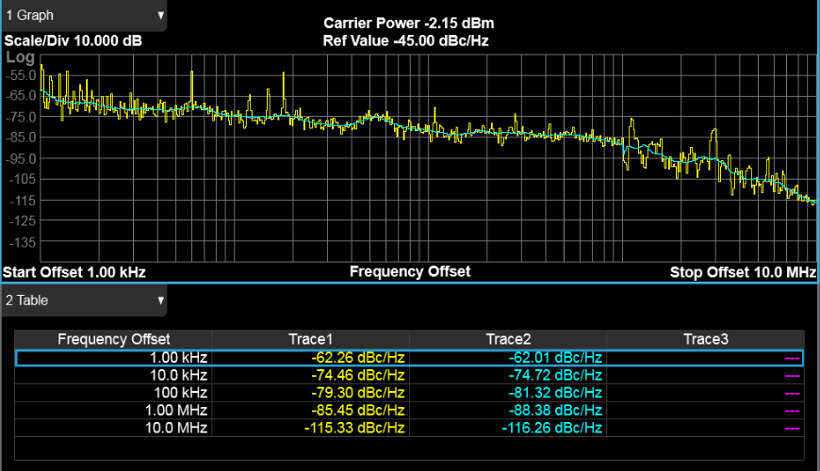
Design of Low Power Transmitter for Biomedical Application in 180nm CMOS
Dae-Hyeon Kwon, Dong-Hyun Youn and Minkyu Je
School of Electrical Engineering, Korea Advanced Institute of Science and Technology (KAIST)
E-mail: eogus47@kaist.ac.kr
Introduction – Low Power Transmitter for Capsule endoscopy
• The Best insurance is regular Endoscopy
- The surest way to detect stomach and colon cancer
- Recommended once every two years for people over 30 years old
• Advantage of capsule Endoscopy
  We can do the examination painless
  We can maintain daily life while doing endoscopy
  We can diagnose diseases of the small intestine
- Probability of discovery issue
1) Using Conventional endoscopy : < 10%
2) Using Capsule endoscopy : 65 ~75 %
Overall Architecture of Transmitter
• High-definition picture should be transmitted outside the person.
• It should be possible to operate for more than 8 hours.
• So, we propose a low power transmitter operating at high data rate ,
and operate more than 8 hours for accurate diagnosis
Chip Implementation
• Circuit Component for transmitter
  Consists of two component
  - Phase-Locked Loops (PLL)
  - Power Amplifier (PA)
  Counter-assisted Fractional N PLL
  - Difficulty of using digital circuit under
  1V supply for low power consumption
  - Can not use DSM for desired frequency
  - Choose PLL without DSM
  - Additionally, No DSM output noise.
  - Good for 16 QAM modulation
  Digital Power Amplifier (DPA)
  - PA is largest power consumption of
  the Transmitter
  - Reduce power consumption as
  reducing circuit that is used in analog
  PA
(a) Fractional-N PLL using delta-sigma modulation
(c) Overall block of Ring DCO
(e) Layout of transmitter ICs
(b) 16 QAM constellation and PA core block
(d) Phase noise of the DCO
(d) Measurement setup
• Resolution of TDC required to make the desired frequency is about 20ps
• DCO consists of Start-up, 4 stage ring oscillator with Fine cap. Bank and Coarse current DAC
• Using varactor capacitor, 1 LSB of frequency resolution in fine cap bank is 100KHz
• In some case, even order ring oscillator cannot oscillate , Need Strat-up circuit is required
Measurement and Simulation Results
(a) PLL phase noise using code
(c) PLL phase noise using Simulink
(e) Measurement of Frequency step of PLL
(b) PLL loop stability using code
(d) PA amplitude simulation
(f) Phase noise of PLL
TABLE 1. Performance of PLL
• Frequency step of PLL is 140KHz when reference clock is 18MHz.
• Expected value of in-band phase noise in simulation is -105dBc/Hz.
• Measurement value of in-band noise -85dBc/Hz.
• Simulation results differ from measurement results due to timing issue of digital filter
Acknowledgement
The chip fabrication and EDA tool were supported by the IC Design Education Center (IDEC), Korea.

